Slide 1
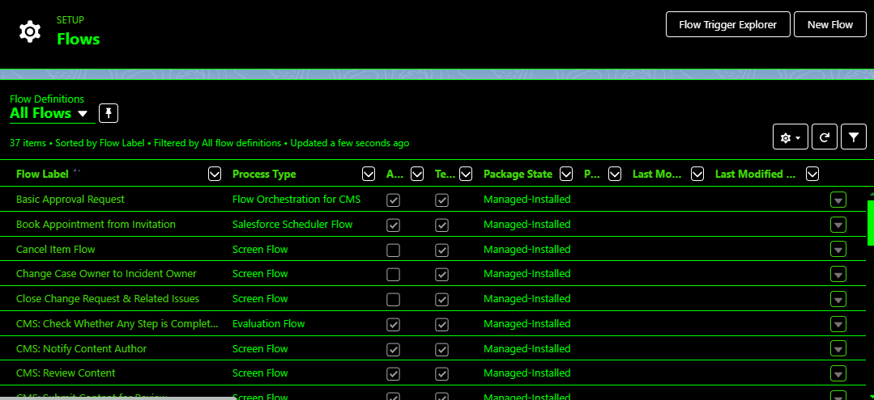
TASK - 4
Automation:
FLOWS

